Slide 1

ARCHITECTURE FRAMEWORK
GROUP 2
MoDAF Framework
IDRIAN LIBO-ON JOHN ALFRED BUTNANDE LESH LIZADES
1
an architecture framework that defines a standardized way of conducting enterprise architecture.
DoDAF Framework
2
defines a common approach for presenting, describing and comparing DoD enterprise architectures across organizational.
FEA Framework
3
the Federal Enterprise Architectural Framework, or FEA, is a system of enterprise architecture specially designed for the federal government.
9/15/2022
1

Slide 2

Front cover
ARCHITECTURE FRAMEWORK
STORY 1 – MoDAF
STORY 2 – DoDAF
STORY 3 – FEA

Slide 3
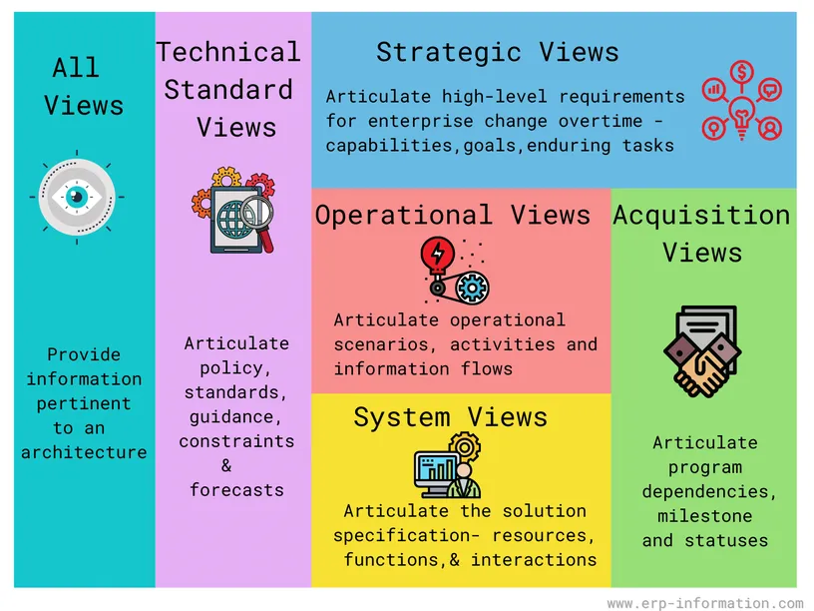
MoDAF Framework
1
MODAF Framework is an architecture framework that defines a standardized way of conducting enterprise architecture. The framework was developed by the UK Ministry of Defense and is used by both the public and private sectors. It provides a way for organizations to design, plan, implement, and govern information systems.
MODAF Framework provides businesses with a standardized way of conducting enterprise architecture. This framework defines a methodology for designing, planning, implementing, and governing information systems. As a result, organizations can save time and money by using it instead of starting from scratch.
MODAF was created by the UK Ministry of Defence and is used extensively by the British MOD and other government agencies. The private sector has also adopted it for use in various industries.

Slide 4
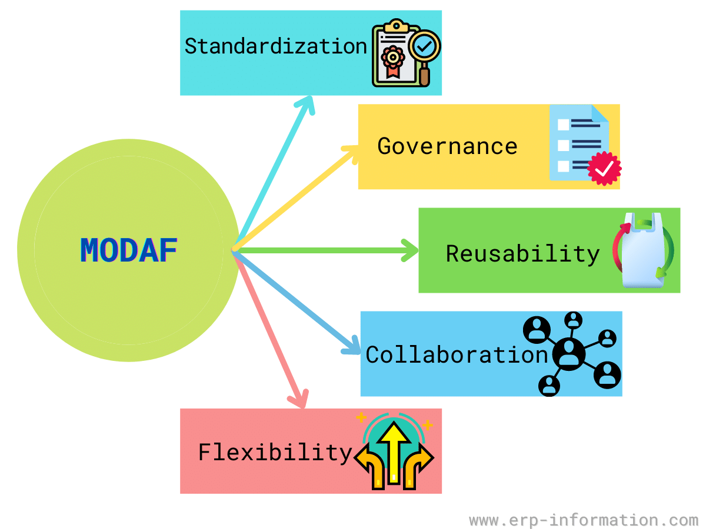
MoDAF Framework
1
Collaboration
It enables collaboration between business and IT teams, which is essential for successful enterprise architecture projects.
Governance
It provides a governance model that ensures the quality and integrity of the architecture. The framework defines a set of processes and procedures for managing MODAF projects, which helps ensure that the architecture meets the organization’s business needs.
Reusability
It promotes reuse by ensuring that MOD architecture is based on reusable components. This helps to reduce costs and boost efficiency in MOD projects.
FIVE CORE ELEMENTS
Flexibility
It is a flexible framework that can be applied to any organization and scaled up or down. It provides an adaptable approach for defining, designing, implementing, and governing information systems.
Standardization
It provides a standardized way of conducting enterprise architecture, enabling organizations to share information and best practices.
Meta-models core elements -System -Process -Products -Data -Organization -Model

Slide 5
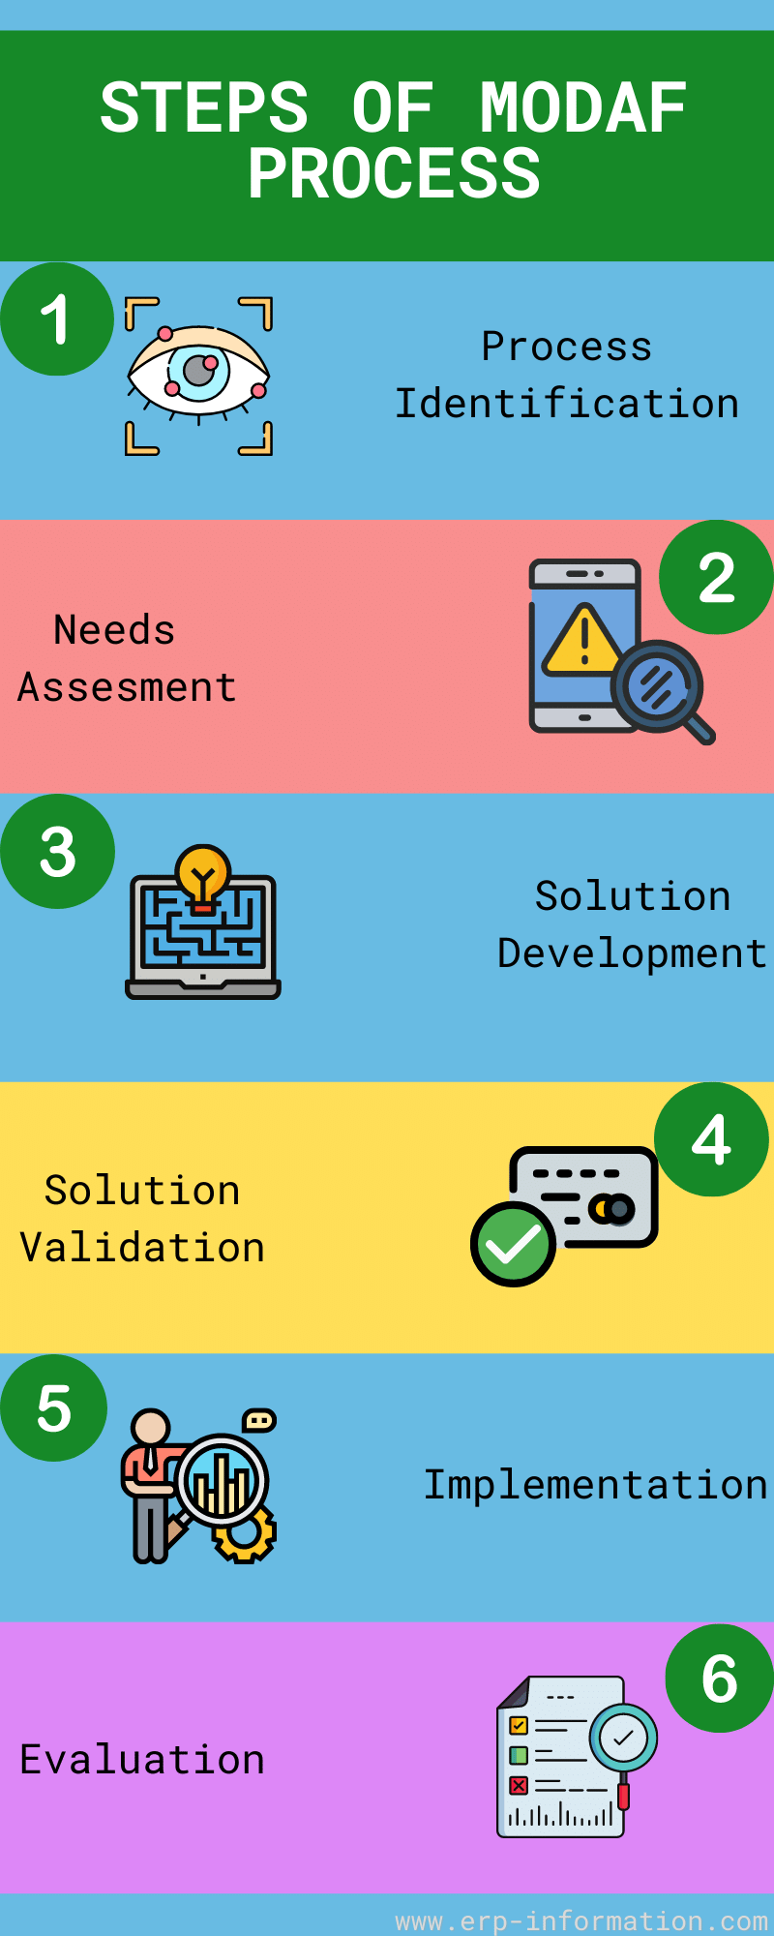
MoDAF Framework
1
Process identification
The first step in this process is to identify a small set of techniques that can be used to create a proof of concept. Once this has been achieved, the organization can model its business processes using MODAF.
Needs assessment
Each project begins with a needs assessment that identifies the business requirements for modeling processes.
The MOD Architecture is used to model all MOD processes, so there must be a clear requirement for this architecture before any work begins.
Solution development
MODAF’s process modeling and design tools can develop a solution that meets the business requirements and complies with MODAF architecture standards.
Solution validation
The solution is validated against MODAF’s process and product models in this step. This ensures that it meets all requirements and is consistent with MODAF’s standards.
Implementation
In the MODAF implementation phase, the MOD processes and MOD products are put into place. The MOD architecture is used to model all processes and products. This means that there must be a clear requirement for this type of architecture before any work begins.
Evaluation
After implementing MOD products and processes, you must evaluate whether they meet the business requirements. MODAF provides many tools for evaluation, including process performance measurement and product conformity assessment.
STEPS OF MODAF’S PROCESS

Slide 6
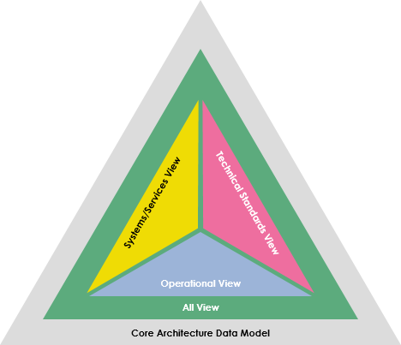
DoDAF Framework
2
Versions 1.5
The Department of Defense Architecture Framework (DoDAF) outlines a standard method for outlining, comparing, and presenting DoD enterprise architectures across joint, organizational, and international boundaries. Additionally, it encourages the application of standard terminology, presumptions, and principles to make integration easier. DoDAF is therefore uniquely suited to large systems with complex integration and interoperability challenges, and its use of "operational views" makes it so. These perspectives provide an overview and specifics aimed at particular stakeholders within their domain and in interaction with other domains in which the system will operate.
Version 1.5
The purpose of DoDAF is to define concepts and models usable in DoD’s six core processes:[6]
Joint Capabilities Integration and Development (JCIDS)
Planning, Programming, Budgeting, and Execution (PPBE)
Defense Acquisition System (DAS)
Systems Engineering (SE)
Operational Planning (OPLAN)
Capability Portfolio Management (CPM)
Why use DoDAF? DoDAF supports individuals who want to switch from conventional systems development processes, which are document-based and code-centric, to Model-Based Engineering processes, which are requirements-driven and architecture-centric.
every significant U.S. Acquisitions of DoD weapons and IT systems must create and document an enterprise architecture (EA) based on the guidelines outlined in the DoDAF. Despite being geared toward military systems, DoDAF is one of many systems architecture frameworks and has wide applicability in the global public, private, and nonprofit sectors.

Slide 7
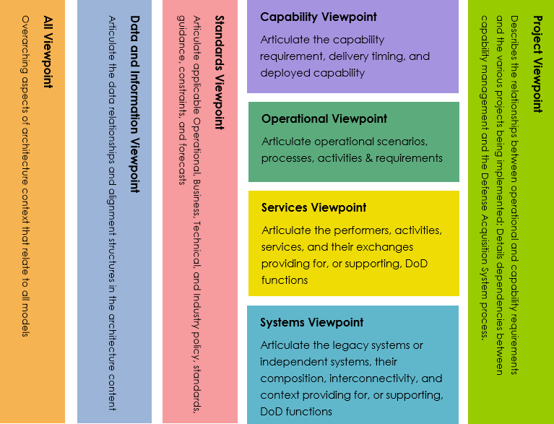
DoDAF Updated
2
Versions 2.0
The current version as of this writing is 2.02 and it had the following specific goals:
Establish guidance for creating architecture content as a function of purpose or “fit for purpose.”
Enhance the effectiveness and utility of architectures through a rigorous data model so that it can be analyzed, evaluated and eventually integrated with more precision. This data model is called the DoDAF Meta Model (DM2).
Updated Viewpoint:
Capability Viewpoint (CV) gets the enterprise goals related to the entire vision for executing a specified course of action. (version 2.02)
Services Viewpoint (SvcV) captures system, service, and interconnection functionality providing for, or supporting, operational activities. (version 2.02)
Project Viewpoint (PV) explains the way by which programs are grouped in organizational terms as an articulated portfolio. (version 2.02)
Data and Information Viewpoint (DIV) captures the business information requirements and structural business process rules for the Architectural Description. (version 2.02)
Operational Viewpoint (OV) encapsulates the organizations, tasks, and information that must be communicated between them to accomplish DoDAF goal.
Systems Viewpoint (SV) captures the information on supporting automated systems, interconnectivity, and other systems functionality in support of operating activities.
Project Viewpoint (PV) explains the way by which programs are grouped in organizational terms as an articulated portfolio.
All Viewpoint (AV) models provide information pertinent to the entire Architectural Description.
Updated Core Architecture Data Model

Slide 8
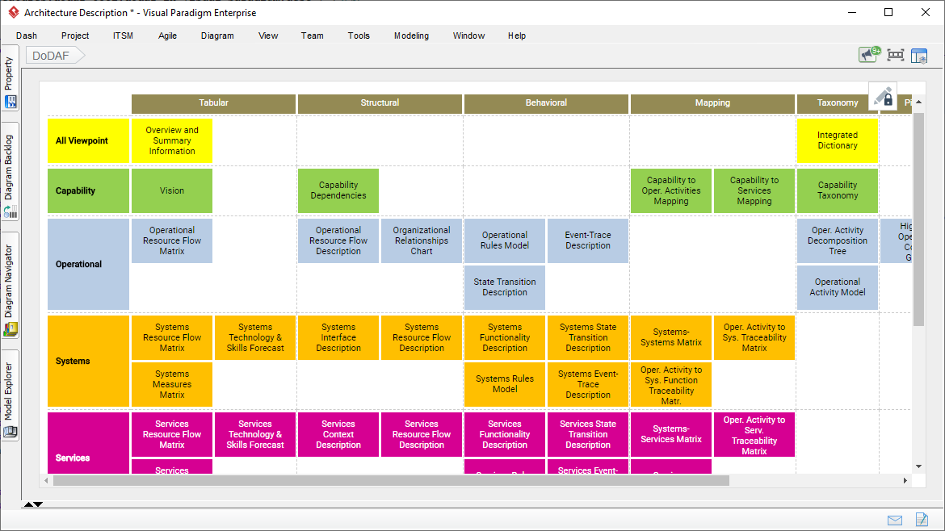
DoDAF Software
2
Visual Paradigm provides an easy-to-use, model-driven DoDAF software that supports the development of DoDAF 2.02 views and models. Create integrated DoDAF products with traceability maintained among views. Generate architectural documents that facilitate organizations to efficiently coordinate enterprise architecture initiatives.

Slide 9
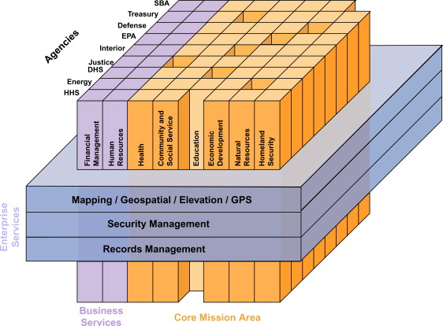
FEA Framework
3
The Federal Enterprise Architecture (FEA) (CIO, 2001) was implemented by the U.S. federal government in an effort to unite its myriad agencies and functions under a common enterprise architecture. The Federal Enterprise Architecture effort is still in its infancy, since most of the major pieces have been available only since 2006. FEA is the most complete of all the methodologies discussed in this chapter. It has both a comprehensive template, like Zachman, and an architectural process, like TOGAF.
The FEA View on Enterprise Architecture
The FEA view on EA is that an enterprise is made up of segments. A segment is a major business functionality, such as human resources. Within FEA, segments are divided into core mission area segments and business services segments. A core mission area segment is one that is central to the purpose of a particular agency within the enterprise. For example, in the Health and Human Services (HHS) agency of the federal government, health is a core mission area segment. A business services segment is one that is foundational to most organizations. For example, financial management is a business services segment that is required by all federal agencies.
Another type of enterprise architecture asset is an enterprise service, which is a well-defined function that spans agency boundaries. An example of an enterprise service is security management. Security management is a service that works in a unified manner across the whole breadth of the enterprise.

Slide 10
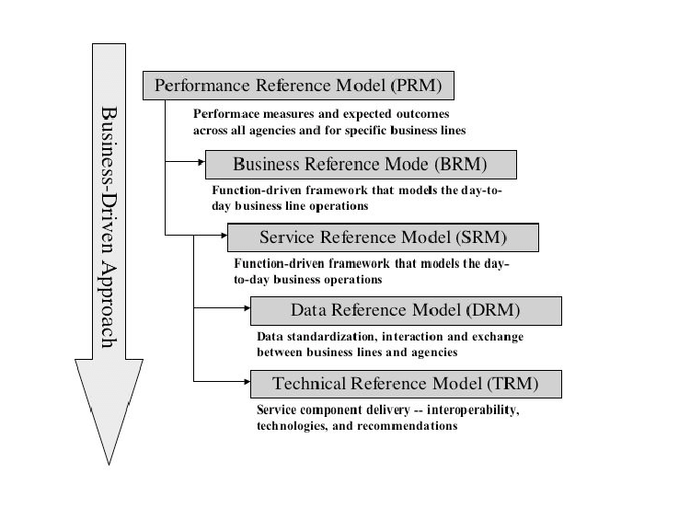
FEA Framework
3
The five FEA reference models
The five FEA reference models are focused on establishing a common business language. The goal is to facilitate communication, cooperation, and collaboration across agency boundaries.
The business reference model (BRM) gives a business view of the various functions of the federal government.
The components reference model (CRM) gives an IT view of systems that can support business functionality.
The technical reference model (TRM) categorizes the various technologies and standards that can be used in building IT systems.
The data reference model (DRM) defines standard ways of describing data.
The performance reference model (PRM) defines standard ways of describing the value delivered by enterprise architectures.

Slide 11
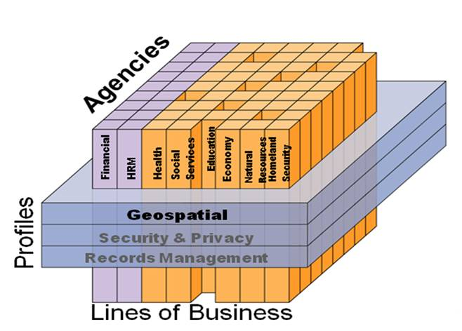
FEA for Your Agency
3
Why use FEA?
if you work in government, you are aware that constituents value effectiveness and efficiency.
With consistent planning and strategic approaches to problem-solving, this methodology aids governments in developing workable solutions to infrastructure and technology issues.
For government organizations that want to increase their organizational efficiency and transparency, hiring an architect or planner is crucial.
This person is essential to each step that prioritizes collaboration between sponsors and stakeholders and removes roadblocks to effective communication.
It benefits everyone when government organizations use FEA to operate more efficiently or effectively.

Slide 12
Back cover
References
Informer, ERP. “MODAF Framework - Standardized Enterprise Architecture.” ERP Information, 7 Feb. 2022, www.erp-information.com/modaf-framework?fbclid=IwAR0IZW05J-BmQeXOwL3gj1mwcH9DNJ0Ong0SachSglJ7HI1N0fTx8xOM3JU.
“What Is DoDAF Framework.” What Is DoDAF Framework, www.visual-paradigm.com/guide/enterprise-architecture/what-is-dodaf-framework/?fbclid=IwAR2MOcwu0R-Dwa5hMzeERJ28w3iJLC7TgMXihp3mPpNiBZias9I8nQ8P5wM. Accessed 15 Sept. 2022.
“Federal Enterprise Architecture - an Overview | ScienceDirect Topics.” Federal Enterprise Architecture - an Overview | ScienceDirect Topics, www.sciencedirect.com/topics/computer-science/federal-enterprise-architecture. Accessed 15 Sept. 2022.
“Introduction to Federal Enterprise Architecture (FEA) – BMC Software | Blogs.” BMC Blogs, 28 Aug. 2019, www.bmc.com/blogs/federal-enterprise-architecture-fea/?fbclid=IwAR3WHW5XlcmAiNdsfNhEBmOwvLXlatNm8RJsmMWMnDOSLS5x7dl7CKRStCE.
Thank you.

